Slide 1


Who Am I in Christ; Who Are We as God’s People? Thinking Biblically about Christian Identity
Reflecting Divinity: Christian Identity and the Restoration of the Divine Image

Slide 2
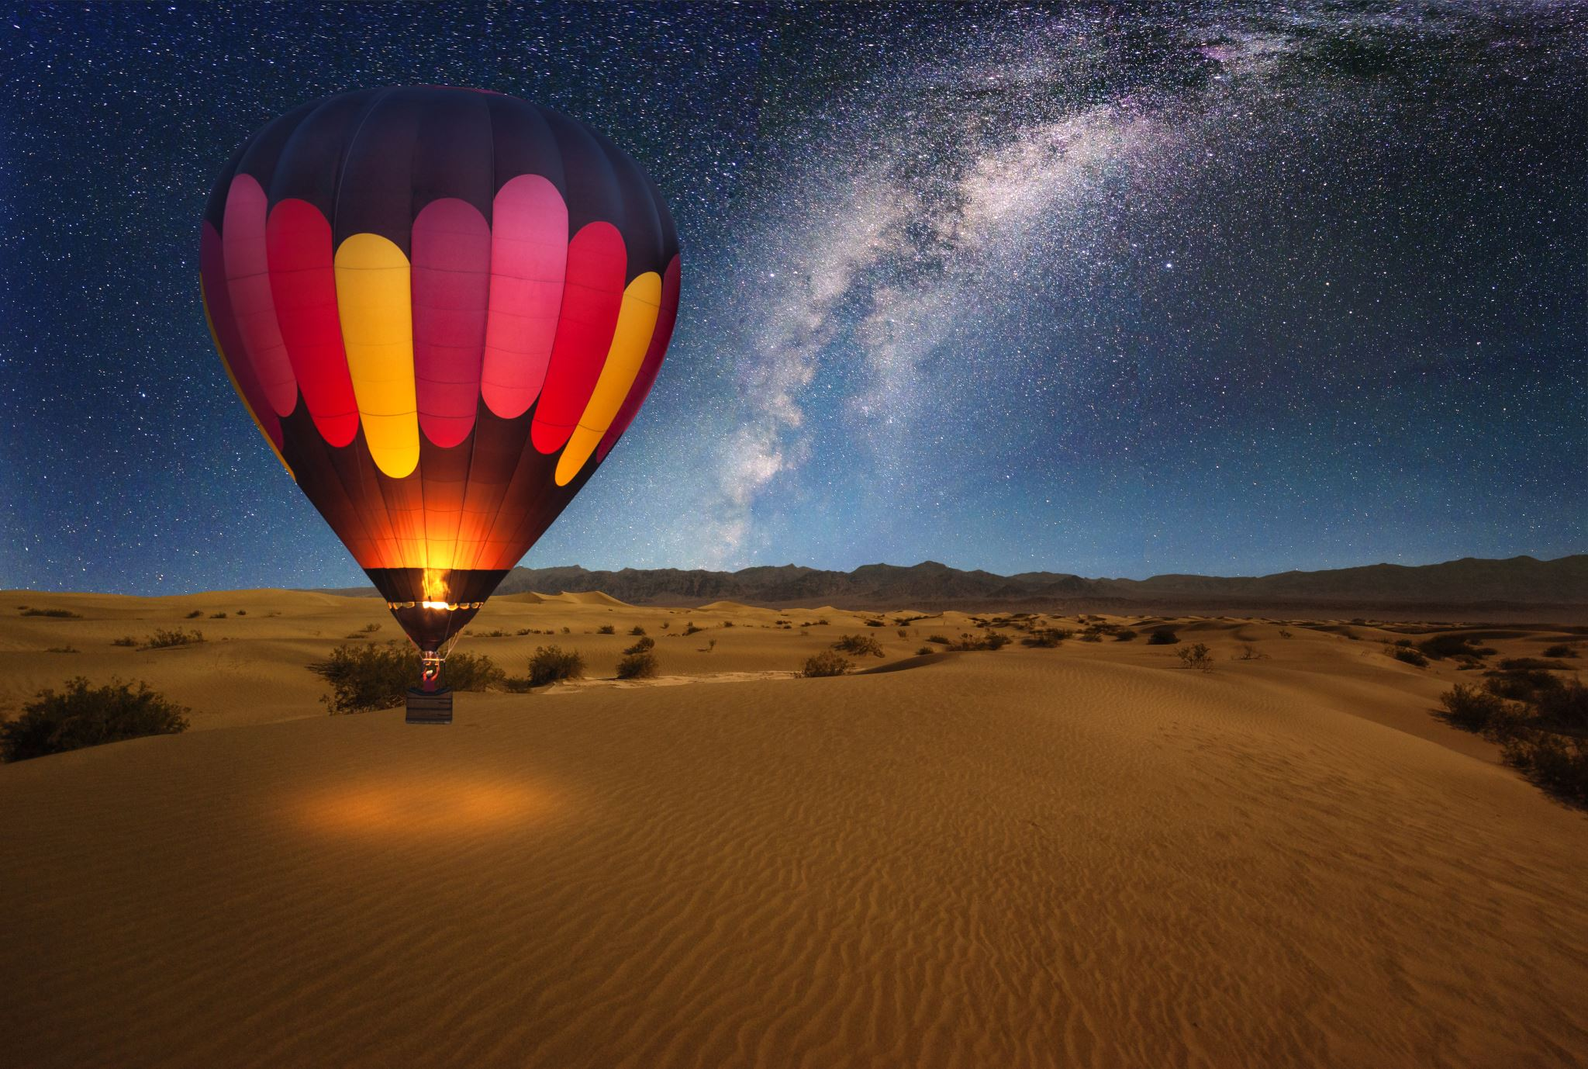
The Bible as the Story of God and Humanity
Creation
  Fall
    Israel
      Jesus
    Spirit
  Ekklesia
Return

Slide 3
1. The Universe is the Temple of God
“Heaven is My throne, and the earth is the footstool for My feet. Where then is a house you could build for Me? And what is the place of my rest”? (Isaiah 66:1).
“He built his sanctuary like the heights, like the earth, which he has founded forever” (Psalm 78:69).
“We ought to look upon the universal world as the highest and truest temple of God, having for its most holy place that most sacred part of the essence of all existing things, namely, the heaven; and for ornaments, the stars; and for priests, the subordinate ministers of his power, namely, the angels…” (Philo, On the Special Laws, 1.66).

Slide 4
Eden = The First Temple? Temple of God (Eden=first temple/tabernacle)
The Lord God planted a garden toward the east, in Eden; and there He placed the man whom He had formed (Gen. 2:8).
¹⁰ Now a river flowed out of Eden to water the garden; and from there it divided and became four rivers (Gen 2:10).
Then he brought me back to the door of the house; and behold, water was flowing from under the threshold of the house toward the east, for the house faced east (Ezek. 47:1).

Slide 5
Eden = The First Temple? Temple of God (Eden=first temple/tabernacle)
¹¹ The name of the first is Pishon; it flows around the whole land of Havilah, where there is gold. ¹² The gold of that land is good; the bdellium and the onyx stone are there as well (Gen. 2:11-12).
⁷ onyx stones and setting stones for the ephod and for the breast-piece… ¹¹ You shall overlay it with pure gold, inside and out you shall overlay it, and you shall make a gold moulding around it (Exod. 25:7, 11).

Slide 6
Eden = The First Temple? Temple of God (Eden=first temple/tabernacle)
8 Now they heard the sound of the Lord God walking in the garden in the cool of the day, and the man and his wife hid themselves from the presence of the Lord God among the trees of the garden (Gen. 3:8).
¹¹ Moreover, I will make My dwelling among you, and My soul will not reject you. ¹² I will also walk among you and be your God, and you shall be My people (Lev. 26:12).

Slide 7
2. God Made Humans in His Image
“I will eliminate the carved image and the cast metal image from the house of your gods” (Nahum 1:14)

Slide 8
2. God Made Humans in His Image
26 Then God said, “Let Us make mankind in Our image, according to Our likeness; and let them rule over the fish of the sea and over the birds of the sky and over the livestock and over all the earth, and over every crawling thing that crawls on the earth.” 27 So God created man in His own image, in the image of God He created him; male and female He created them (Gen. 1:26-27; cf. 5:1; 9:6).

Slide 9
Worship = Reflecting the Image of God
Worship is in fact the goal of mission in Eden, filling the earth by multiplying image bearers in the temple of God’s presence who would worship and reflect God’s glory to the ends of the earth.
Beale, G. K., & Kim, M. (2021). God Dwells among Us: A Biblical Theology of the Temple (p. 17). IVP Academic: An Imprint of InterVarsity Press

Slide 10
3. Image and Glory are Connected
Adam, our father, you fashioned in the image of your glory … the breath of life you blew into his nostril (4Q504, fr. 8, 1:4-6);
7 For a man should not have his head covered, since he is the image and glory of God… (1 Cor. 11:7);
18 But we all, with unveiled faces, looking as in a mirror at the glory of the Lord, are being transformed into the same image from glory to glory, just as from the Lord, the Spirit (2 Cor. 3:18);
25 For she is a breath of the power of God, and a pure emanation of the glory of the Almighty; therefore, nothing defiled gains entrance into her. 26 For she is a reflection of eternal light, a spotless mirror of the working of God, and an image of his goodness (Wisdom of Solomon 7:25 –26).

Slide 11
Romans 1:20–25
20 For since the creation of the world His invisible attributes, that is, His eternal power and divine nature, have been clearly perceived, being understood by what has been made, so that they are without excuse. 21 For even though they knew God, they did not honour Him as God or give thanks, but they became futile in their reasonings, and their senseless hearts were darkened. 22 Claiming to be wise, they became fools, 23 and they exchanged the glory of the incorruptible God for an image in the form of corruptible mankind, of birds, four-footed animals, and crawling creatures [Psalm 106:20]. 24 Therefore God gave them up to vile impurity in the lusts of their hearts, so that their bodies would be dishonoured among them. 25 For they exchanged the truth of God for falsehood and worshiped and served the creature rather than the Creator, who is blessed forever. Amen.

Slide 12
Psalm 115: 3–8
Our God is in the heavens; He does all that he pleases. Their idols are silver and gold, the work of human hands. They have mouths, but do not speak; eyes, but do not see. They have ears, but do not hear; noses, but do not smell. They have hands, but do not feel; feet, but do not walk; and they do not make a sound in their throat. Those who make them become like them; so do all who trust in them.

Slide 13
Psalm 135:15–18
15 The idols of the nations are nothing but silver and gold, the work of human hands. 16 They have mouths, but they do not speak; they have eyes, but they do not see; 17 they have ears, but they do not hear, nor is there any breath at all in their mouths. 18 Those who make them will become like them, Yes, everyone who trusts in them

Slide 14
2 Kings 17:15
¹⁵ They rejected His statutes and His covenant which He made with their fathers, and His warnings which He gave them. And they followed idols and became empty, and followed the nations that surrounded them, about which the Lord had commanded them not to do as they did.

Slide 15
2 Samuel 7:1–7
Now it came about, when the king lived in his house, and the Lord had given him rest on every side from all his enemies, 2 that the king said to Nathan the prophet, “See now, I live in a house of cedar, but the ark of God remains within the tent.” 3 Nathan said to the king, “Go, do all that is in your mind, for the Lord is with you.” 4 But in the same night, the word of the Lord came to Nathan, saying, 5 “Go and say to My servant David, ‘This is what the Lord says: “Should you build Me a house for My dwelling? 6 For I have not dwelt in a house since the day I brought up the sons of Israel from Egypt, even to this day; rather, I have been moving about in a tent, that is, in a dwelling place. 7 Wherever I have gone with all the sons of Israel, did I speak a word with one of the tribes of Israel, whom I commanded to shepherd My people Israel, saying, ‘Why have you not built Me a house of cedar?’”’

Slide 16
2 Samuel 7: 11b–14a
The Lord also declares to you that the Lord will make a house for you. 12 When your days are finished and you lie down with your fathers, I will raise up your descendant after you who will come from you, and I will establish his kingdom. 13 He shall build a house for My name, and I will establish the throne of his kingdom forever. 14 I will be a father to him and he will be a son to Me.

Slide 17
Romans 1:3–4 reflecting 2 Samuel 7:12
Paul, a bond-servant of Christ Jesus, called as an apostle, set apart for the gospel of God, ² which He promised beforehand through His prophets in the holy Scriptures, ³ concerning His Son, who was born of a descendant of David according to the flesh, ⁴ who was declared the Son of God with power according to the Spirit of holiness by the resurrection from the dead, Jesus Christ our Lord,

Slide 18

John 1:1–4, 14
In the beginning was the Word, and the Word was with God, and the Word was God. 2 He was in the beginning with God. 3 All things came into being through Him, and apart from Him not even one thing came into being that has come into being. 4 In Him was life, and the life was the Light of mankind… 14 And the Word became flesh and dwelt (ἐσκήνωσεν) among us; and we saw His glory, glory as of the only Son from the Father, full of grace and truth…

Slide 19
John 2:15–22
15 And He made a whip of cords, and drove them all out of the temple area, with the sheep and the oxen; and He poured out the coins of the money changers and overturned their tables; 16 and to those who were selling the doves He said, “Take these things away from here; stop making My Father’s house a place of business!” 17 His disciples remembered that it was written: “Zeal for Your house will consume me.” 18 The Jews then said to Him, “What sign do You show us as Your authority for doing these things?” 19 Jesus answered them, “Destroy this temple, and in three days I will raise (ἐγερῶ) it up.” 20 The Jews then said, “It took forty-six years to build this temple, and yet You will raise (ἐγερεῖς) it up in three days?” 21 But He was speaking about the temple of His body. 22 So when He was raised (ἠγέρθη) from the dead, His disciples remembered that He said this; and they believed the Scripture and the word which Jesus had spoken

Slide 20
Jesus = The Bridge between Heaven and Earth
⁵¹ And He said to him, “Truly, truly, I say to you, you will see heaven opened and the angels of God ascending and descending on the Son of Man” (John 1:51).
¹² And he had a dream, and behold, a ladder was set up on the earth with its top reaching to heaven; and behold, the angels of God were ascending and descending on it (Gen 28:12).

Slide 21
Acts 17:16, 22–25
16 Now while Paul was waiting for them in Athens, his spirit was being provoked within him as he observed that the city was full of idols… Some were saying, “What could this word scavenger want to say?” Others, “He seems to be a proclaimer of strange deities,”—because he was preaching Jesus and the resurrection… 22 So Paul stood in the midst of the Areopagus and said, “Men of Athens, I see that you are very religious in all respects. 23 For while I was passing through and examining the objects of your worship, I also found an altar with this inscription, ‘TO AN UNKNOWN GOD.’ Therefore, what you worship in ignorance, this I proclaim to you. 24 The God who made the world and everything that is in it, since He is Lord of heaven and earth, does not dwell in temples made by hands; 25 nor is He served by human hands, as though He needed anything, since He Himself gives to all people life and breath and all things

Slide 22
Acts 17:29–31
29 Therefore, since we are the descendants of God, we ought not to think that the Divine is like gold or silver or stone, an image formed by human skill and thought. 30 So having overlooked the times of ignorance, God is now proclaiming to mankind that all people everywhere are to repent, 31 because He has set a day on which He will judge the world in righteousness through a Man whom He has appointed, having furnished proof to all people by raising Him from the dead”

Slide 23
2 Corinthians 5:15–17
He died for all, so that those who live would no longer live for themselves, but for Him who died and rose on their behalf. 16 Therefore from now on we recognize no one by the flesh; even though we have known Christ by the flesh, yet now we know Him in this way no longer. 17 Therefore if anyone is in Christ, this person is a new creation.

Slide 24

Reflection Questions
Q1: What is the chief takeaway regarding Christian identity from today?
Q2: What aspect of your social identity (race, ethnicity, gender, social status, political persuasion, etc.) do you find most difficult to reconcile with your identity as a woman/man of God?
Q3: How might reflecting on identity help you navigate trauma/suffering?
Do you have any questions?

