Slide 1


Who Am I in Christ; Who Are We as God’s People? Thinking Biblically about Christian Identity
Journeys through the Desert: Christian Identity and the Theology of Wilderness

Slide 2
David Pocta, Cries from the Wilderness: Reimagining Church Culture in an Age of Uncertainty (London: Lexington Books, 2023), 111
Wilderness is where God does God’s work in forming God’s people. And, notably, wilderness always comes after the initial establishment of relationship or freedom granted between God and the individual or community. Wilderness’ purpose is purgation, formation, and union with God. God uses wilderness to prepare his people for works of service, ultimately to assist them in becoming what God intends, so that they can be used for God’s purposes.

Slide 3


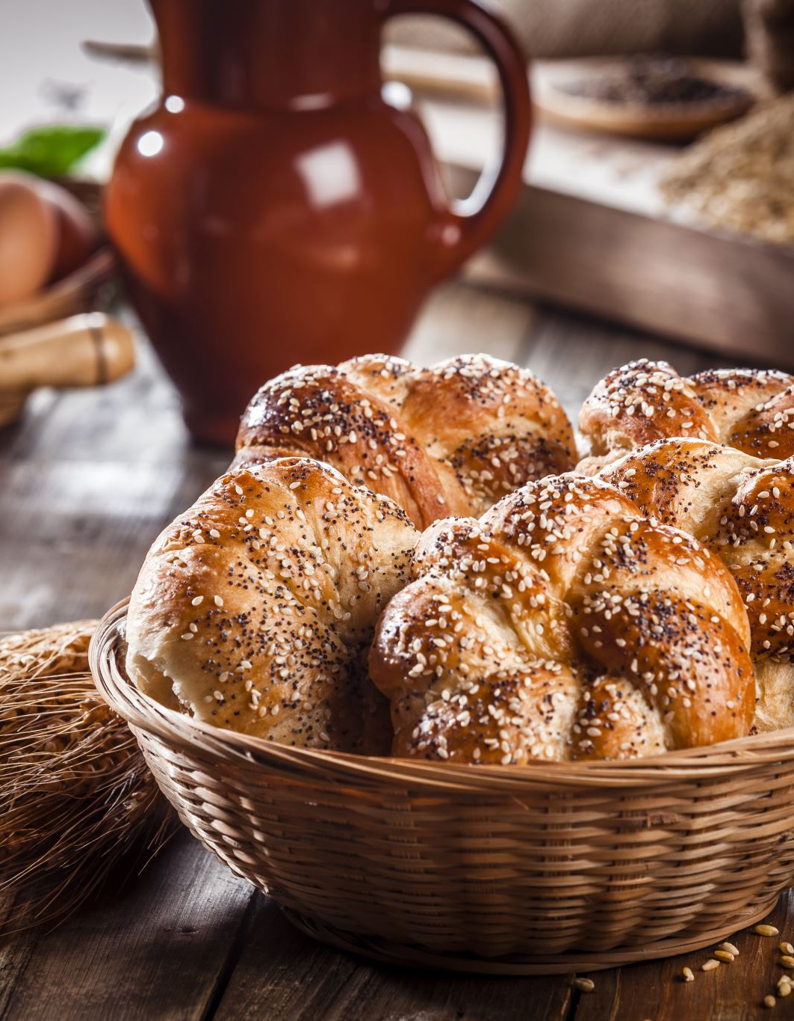
Deuteronomy 8:3
And He humbled you and let you go hungry and fed you with the manna which you did not know, nor did your fathers know, in order to make you understand that man shall not live on bread alone, but man shall live on everything that comes out of the mouth of the Lord.

Slide 4
Matthew 4:1–4
Then Jesus was led up by the Spirit into the wilderness to be tempted by the devil. ² And after He had fasted for forty days and forty nights, He then became hungry. ³ And the tempter came and said to Him, “If You are the Son of God, command that these stones become bread.” ⁴ But He answered and said, “It is written: ‘Man shall not live on bread alone, but on every word that comes out of the mouth of God.’”

Slide 5
Matthew 4:6
⁶ and he said to Him, “If You are the Son of God, throw Yourself down; for it is written:
‘He will give His angels orders concerning You’;
And ‘On their hands they will lift You up,
So that You do not strike Your foot against a stone.’”

Slide 6
Matthew 27:39–40
³⁹ And those passing by were speaking abusively to Him, shaking their heads, ⁴⁰ and saying, “You who are going to destroy the temple and rebuild it in three days, save Yourself! If You are the Son of God, come down from the cross.”

Slide 7

Hebrews 1:1–3
God, after He spoke long ago to the fathers in the prophets in many portions and in many ways, ² in these last days has spoken to us in His Son, whom He appointed heir of all things, through whom He also made the world. ³ And He is the radiance of His glory and the exact representation of His nature and upholds all things by the word of His power. When He had made purification of sins, He sat down at the right hand of the Majesty on high…

Slide 8

Psalm 95:6–11
6 Come, let’s worship and bow down, let’s kneel before the Lord our Maker. 7 For He is our God, And we are the people of His pasture and the sheep of His hand. Today, if you will hear His voice, 8 Do not harden your hearts as at Meribah, as on the day of Massah in the wilderness, 9 “When your fathers put Me to the test, they tested Me, though they had seen My work. 10 For forty years I was disgusted with that generation, and said they are a people who err in their heart, and they do not know My ways. 11 Therefore I swore in My anger, they certainly shall not enter My rest.

Slide 9
Hebrews 3:7–19
7 So, as the Holy Spirit says: “Today, if you hear his voice, 8 do not harden your hearts as you did in the rebellion, during the time of testing in the wilderness, 9 where your ancestors tested and tried me, though for forty years they saw what I did. 10 That is why I was angry with that generation; I said, ‘Their hearts are always going astray, and they have not known my ways.’ 11 So I declared on oath in my anger, ‘They shall never enter my rest.’” 12 See to it, brothers and sisters, that none of you has a sinful, unbelieving heart that turns away from the living God. 13 But encourage one another daily, as long as it is called “Today,” so that none of you may be hardened by sin’s deceitfulness.

Slide 10
Hebrews 3:7–19
14 We have come to share in Christ, if indeed we hold our original conviction firmly to the very end. 15 As has just been said: “Today, if you hear his voice, do not harden your hearts as you did in the rebellion.” 16 Who were they who heard and rebelled? Were they not all those Moses led out of Egypt? 17 And with whom was he angry for forty years? Was it not with those who sinned, whose bodies perished in the wilderness? 18 And to whom did God swear that they would never enter his rest if not to those who disobeyed? 19 So we see that they were not able to enter, because of their unbelief.

Slide 11
Hebrews 2:10–15
10 In bringing many sons and daughters to glory, it was fitting that God, for whom and through whom everything exists, should make the pioneer of their salvation perfect through what he suffered. 11 Both the one who makes people holy and those who are made holy are of the same family. So, Jesus is not ashamed to call them brothers and sisters. 12 He says, “I will declare your name to my brothers and sisters; in the assembly I will sing your praises.” 13 And again, “I will put my trust in him.” And again, he says, “Here am I, and the children God has given me.” 14 Since the children have flesh and blood, he too shared in their humanity so that by his death he might break the power of him who holds the power of death—that is, the devil— 15 and free those who all their lives were held in slavery by their fear of death

Slide 12

Hebrews 4:14–16
Therefore, since we have a great high priest who has ascended into heaven, Jesus the Son of God, let us hold firmly to the faith we profess. 15 For we do not have a high priest who is unable to empathize with our weaknesses, but we have one who has been tempted in every way, just as we are—yet he did not sin. 16 Let us then approach God’s throne of grace with confidence, so that we may receive mercy and find grace to help us in our time of need.

Slide 13

Apophatic and Cataphatic
Apophatic - represents the path of knowing God by negation. Proponents of this pathway suggest God cannot be known by ideas, images, and language – He can only be known in the darkness by detachment, prayerful silence, and contemplation.
Cataphatic - knowing God by affirmation, namely, through His self-revelation understood by the intellect and senses – so we find Him in biblical teaching, communion and other symbols of the faith.

Slide 14
Hebrews 5:11–6:1, my translation.
Concerning which, there is a lot for us to say, and it is difficult to explain, since your ability to listen has become dull. For indeed, you are obliged by now to be teachers, but you have need of someone to teach you again the basic building blocks of the oracles of God, like those who have need of milk, not solid food. For all those partaking in milk are unfamiliar with the word of righteousness, for they are infants; but solid food is for the mature, who on the basis of practice, have been training the capacity for discernment between what is good and what is evil. (6:1) Therefore, having moved on from the discourse about the beginning of Messiah, we might move on to maturity, not again laying down the foundation of repentance from works of death and trust in God

Slide 15
Hebrews 9:6–14
6 When everything had been arranged like this, the priests entered regularly into the outer room to carry on their ministry. 7 But only the high priest entered the inner room, and that only once a year, and never without blood, which he offered for himself and for the sins the people had committed in ignorance. 8 The Holy Spirit was showing by this that the way into the Most Holy Place had not yet been disclosed as long as the first tabernacle was still functioning. 9 This is an illustration for the present time, indicating that the gifts and sacrifices being offered were not able to clear the conscience of the worshiper.

Slide 16
Hebrews 9:6–14
10 They are only a matter of food and drink and various ceremonial washings—external regulations applying until the time of the new order… 13 The blood of goats and bulls and the ashes of a heifer sprinkled on those who are ceremonially unclean sanctify them so that they are outwardly clean. 14 How much more, then, will the blood of Christ, who through the eternal Spirit offered himself unblemished to God, cleanse our consciences from acts that lead to death, so that we may serve the living God!

Slide 17
Hebrews 10:15–17
15 The Holy Spirit also testifies to us about this. First, he says: 16 “This is the covenant I will make with them after that time, says the Lord. I will put my laws in their hearts, and I will write them on their minds.” 17 Then he adds: “Their sins and lawless acts I will remember no more”.

Slide 18
The Life God Blesses by Gordon McDonald
1. Whom are you trying to please?
2. What insecurities are you pampering?
3. With whom or what are you competing?
4. What rewards are you seeking?
5. What shame are you covering?
6. Are you someone who's constantly asking yourself if you are enough?
7. What gift has God given to you that you are sharpening?

Slide 19
David Pocta, Cries from the Wilderness: Reimagining Church Culture in an Age of Uncertainty (London: Lexington Books, 2023), 186.
I believe the church is in the wilderness, and not because God is displeased. We are here because of love and for love. God is doing God’s work to help us. We need to reimagine a church culture that is nurturing and full of faith, hope, and love.

Slide 20
Reflection Questions
(1) What questions would you pursue if you what unashamed to ask? What does it mean to approach God's throne with confidence?
(2) What does moving on to maturity and complexity look like to you? What questions would you bring to the table help a community deepen its friendship with God?
(3) Whom are you trying to please? What insecurities are you pampering? With whom or what are you competing? What rewards are you seeking? What shame are you covering?

